Slide 1
Restaurant Management System
6005 CEM Security
Group Members:
Damien Tan Lek Khee
Lim Pau Thing
Ooi Ying Jie

Slide 2
TABLE OF CONTENTS
01
02
03
04
05
06
Introduction
SQL Statement
Input Validation
ReCAPTCHA
Password Hashing
Overall
Achievements

Slide 3

01
Introduction

Slide 4
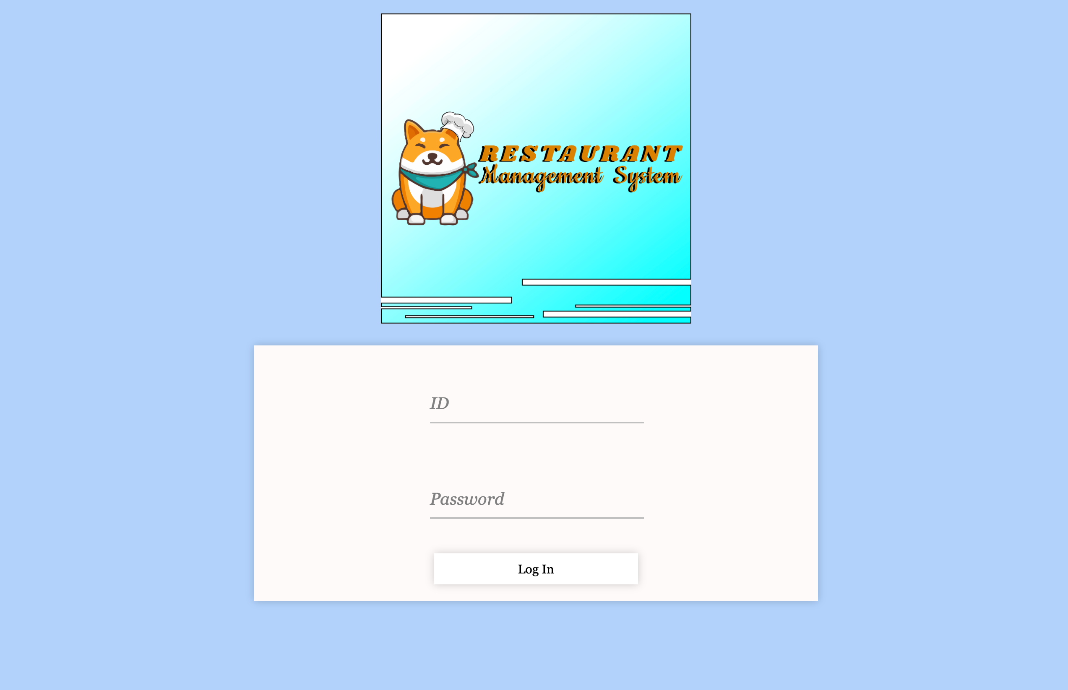
System Overview
Restaurant Management System
Facilitate ordering and reservation processes for restaurant staff.
Staff can place food orders.
Staff can manage customer reservations.

Slide 5
02
SQL Statement

Slide 6
Modify SQL Statements
SQL Injection:
  A common attack where malicious SQL code is inserted into user input fields.
  Attackers exploit vulnerabilities in poorly constructed SQL queries, gaining unauthorized access to a database.
Preventing SQL Injection:
  Prepared statements act as a robust defense against SQL injection attacks.

Slide 7
Modify SQL Statements
Use of Prepared Statements:
  Implementation employs ‘mysqli_prepare’ to prepare an SQL statement for execution to counteract SQL injection attacks.
Parameter Binding and Data Type Specification:
  Parameters are binded using ‘mysqli_stmt_bind_param’.
  Data type specification ensures accurate data processing.
Query Execution:
  ‘mysqli_stmt_execute’ is utilized to execute the prepared statement and fetch the data.
  Enables safe processing of data, preventing malicious injections.
Operation Impact:
  ‘mysqli_stmt_affected_rows‘ is employed to return the number of rows affected by the executed statement.

Slide 8
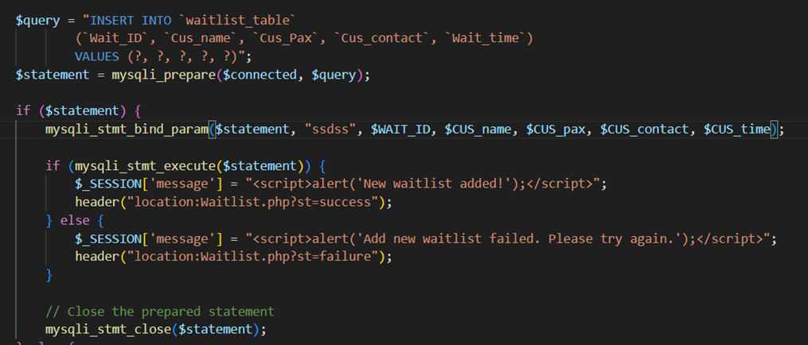
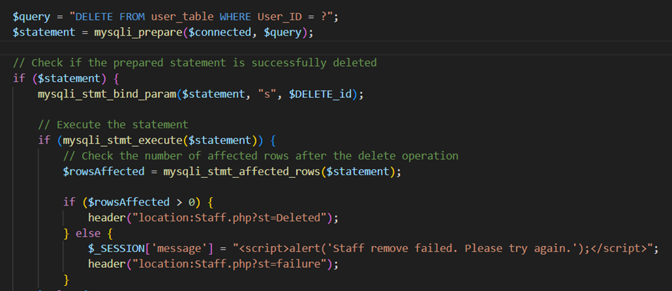
Examples of SQL Statement

Slide 9

04
Input Validation

Slide 10
Input Validation and Error Handling
Implemented thorough input validation to mitigate security risks, specifically addressing concerns like SQL injection.
Enhanced error handling codes to ensure clear error messages while safeguarding confidential data.
Reasons
Preventing Security Risks
  Ensures that user input is thoroughly checked before interacting with the database, reducing the risk of malicious attacks
Clear Error Handling
  Helps in diagnosing issues without compromising data confidentiality

Slide 11
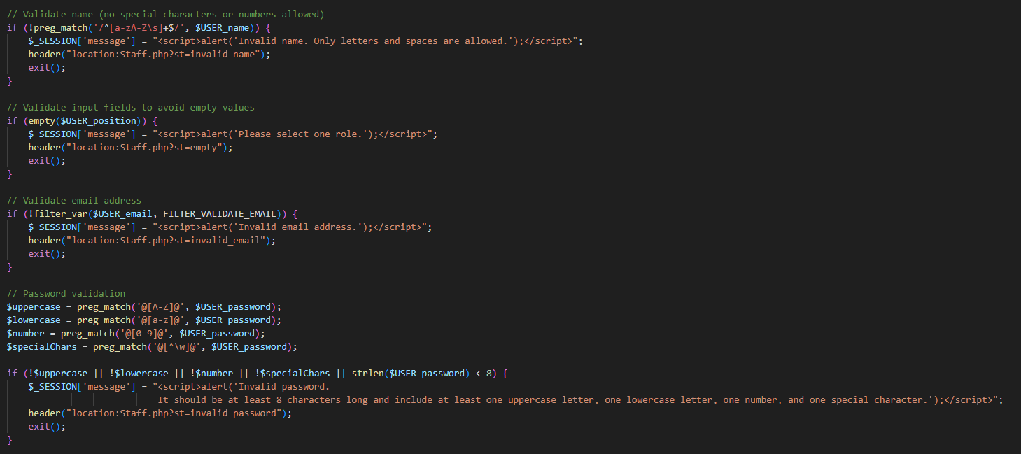
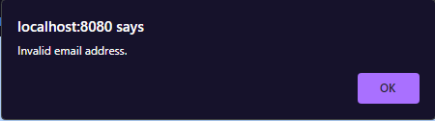
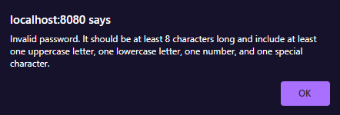
Examples of Input Validation
When a user attempts to register with an invalid email address or a password that doesn't meet the criteria, the system responds with a clear error message, guiding the user on the correct input format.

Slide 12
05
Password Hashing Algorithm

Slide 13
Password Hashing Algorithm
Integrated a robust and trustworthy hashing algorithm to enhance the security of stored passwords.
Improved existing password hashing codes to counter the risk associated with storing passwords in plaintext.
Reasons
Protecting Sensitive Data
  Ensures that passwords are securely stored, reducing the likelihood of unauthorized access even if the database is compromised.
Lowering Security Risks
  Using a tested algorithm adds an extra layer of security, making it harder for attackers to decipher stored password information.

Slide 14
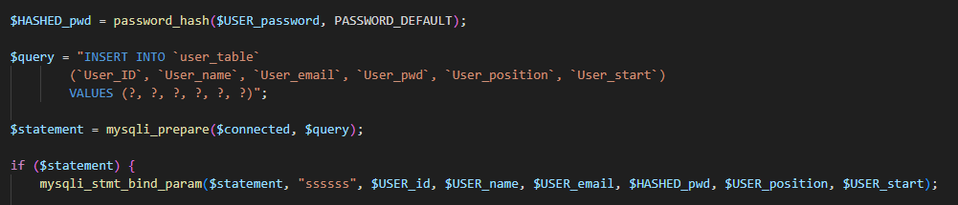
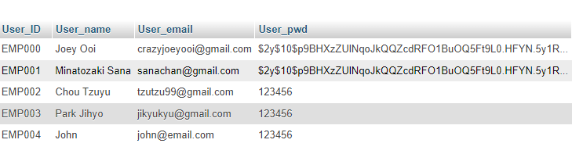
Examples of Password Hashing
This function securely hashes the user's input password using a one-way cryptographic algorithm.

Slide 15
06
ReCAPTCHA

Slide 16
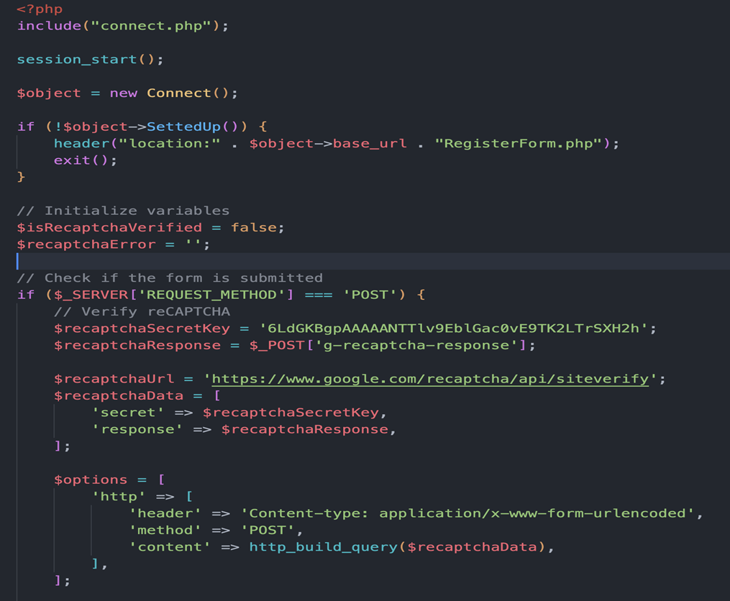
ReCAPTCHA Algorithm

Slide 17
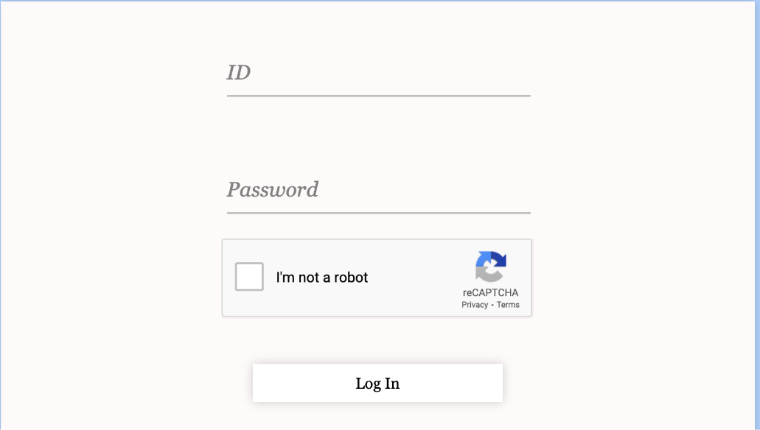
ReCAPTCHA Algorithm
Mitigate automated login attempts and enhance overall authentication security.
Provided an additional layer of defense against malicious bots and potential brute-force attacks.

Slide 18
07
Overall Achievements

Slide 19
Overall Achivements
Mitigate the risk of SQL Injection
Significantly lowered the likelihood of unauthorized data access
Strengthened password security by storing only hashed representations
Enhanced user authentication
Additional layer of protection against automated attacks

Slide 20
Thank You

